Slide 1


Kafka Internal

Slide 2
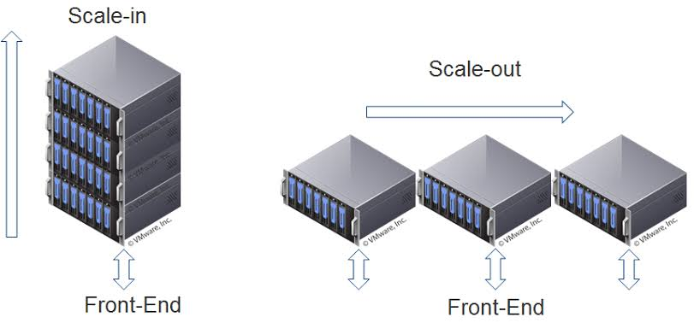
What, why using Cluster ?
Simple: Cluster == multi server
To gain:
Scalability
high availability

Slide 3
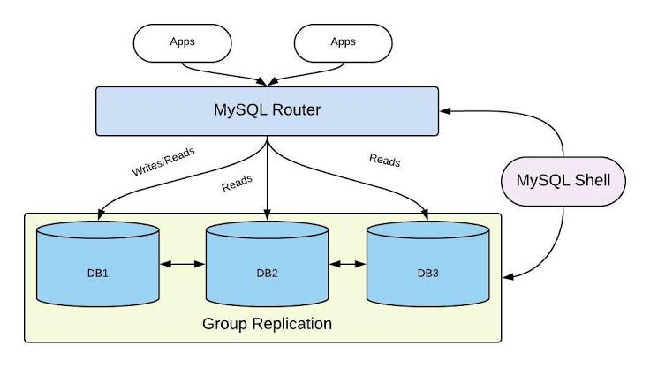
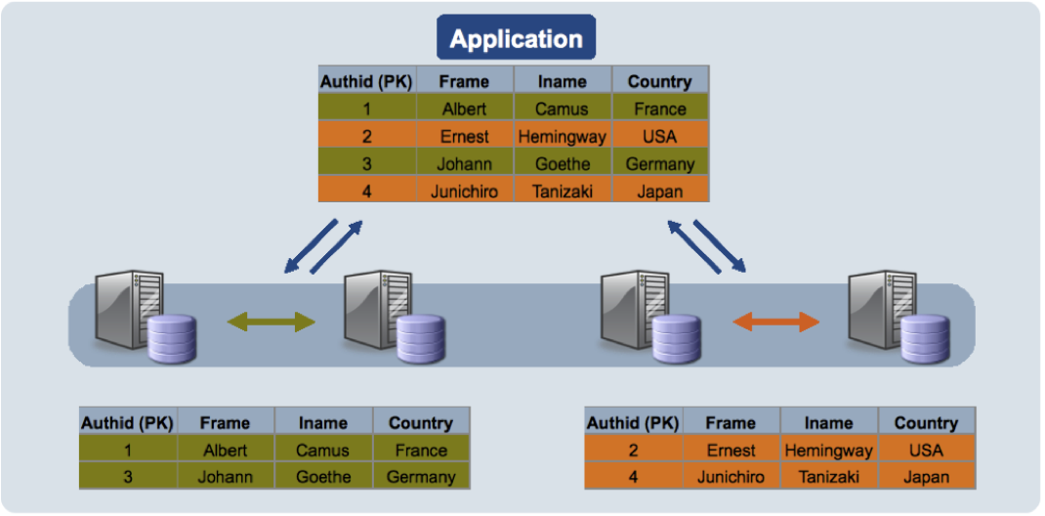
Example of Cluster in mysql
Read, write replica model
Read-heavy system
Sharding
Write-heavy system

Slide 4
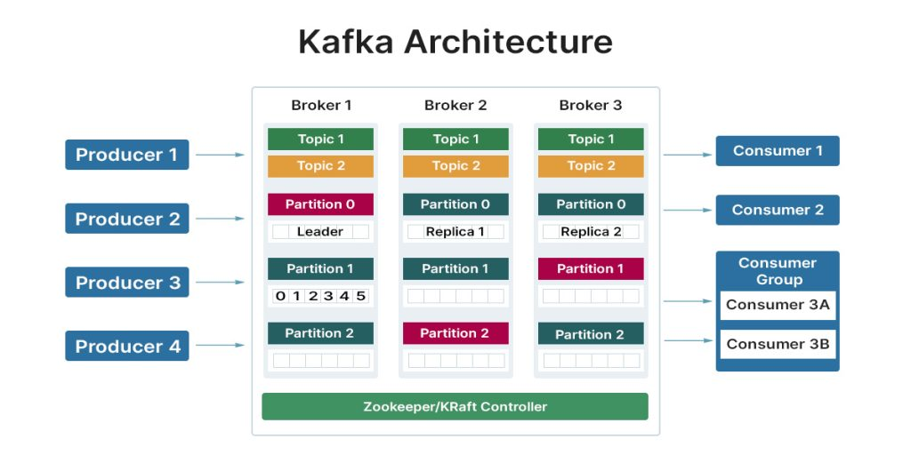
Cluster membership
A Kafka cluster is a distributed, highly scalable system composed of multiple servers (vm, bare-metal) called ( brokers )
https://thomaswong.tech/general/kafka/2025/07/17/kafka_cluster_membership_blog.html

Slide 5

Zookeeper / Kraft Controller
Zookeeper:
Choosing a leader broker (called controller election)
Keeping track of topics, partitions, and replicas ( metadata, node health check )
Detecting when a broker joins or leaves the cluster

Slide 6
Zookeeper Limitation
https://www.confluent.io/learn/zookeeper-kafka/#zookeeper-vs-kraft-a-complete-side-by-side-comparison
Metadata write throughput was limited ( add topics, partitions , brokers,…)
Two distributed system to manage: kafka itself and zookeeper ( extra conf, monitoring, alerting )

Slide 7
Kraft solved it !!!
Kafka’s built-in Raft-based metadata
Kraft uses Raft consensus to elect a leader internally -> faster fail over (zookeeper leader election algorithm https://www.chengweiyang.cn/2014/07/05/how-zookeeper-leader-election-works/ )

Slide 8
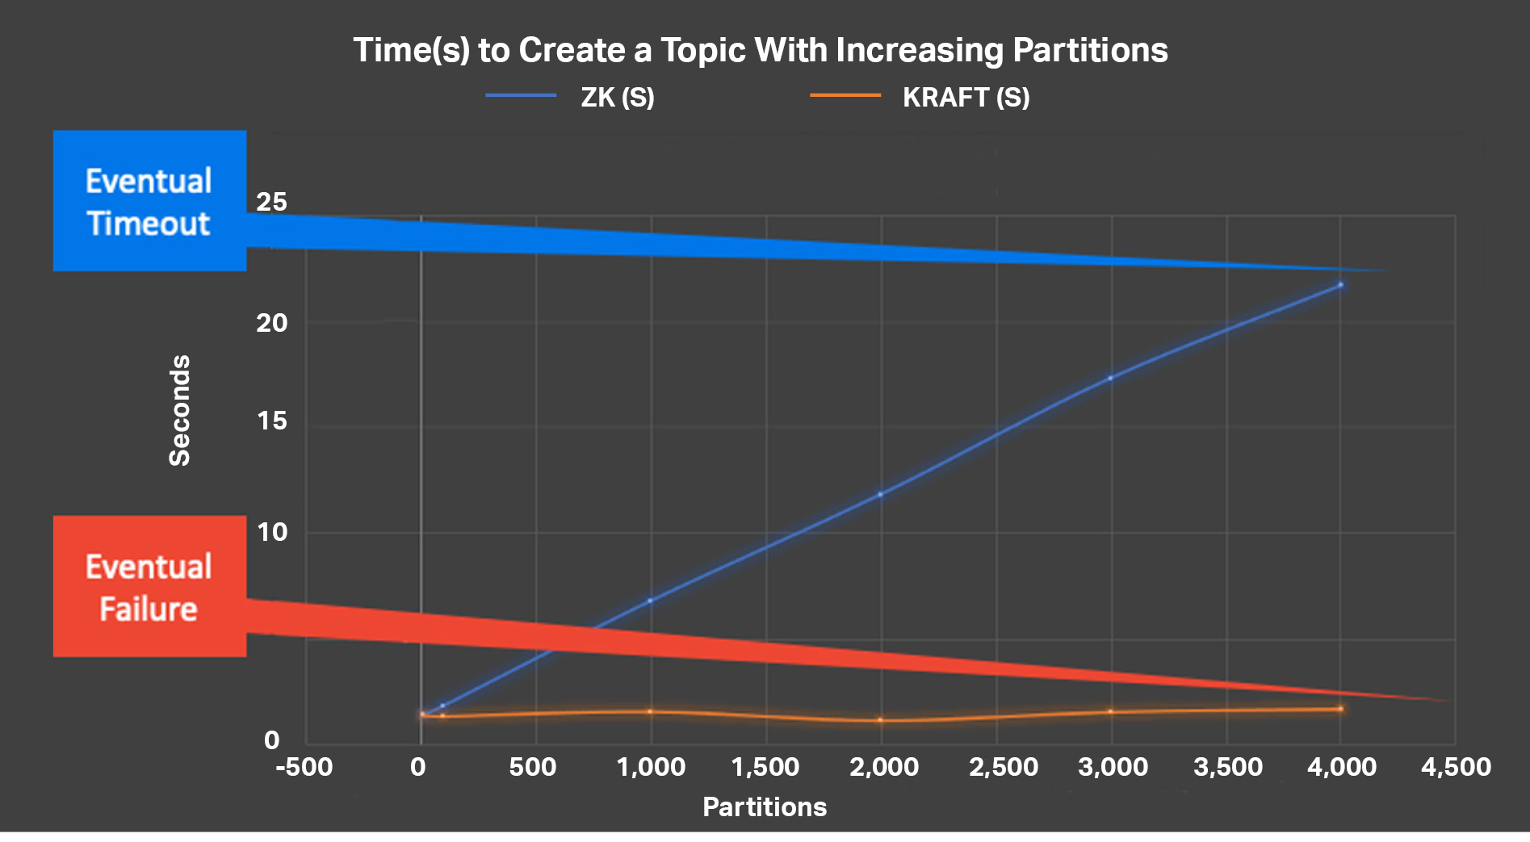
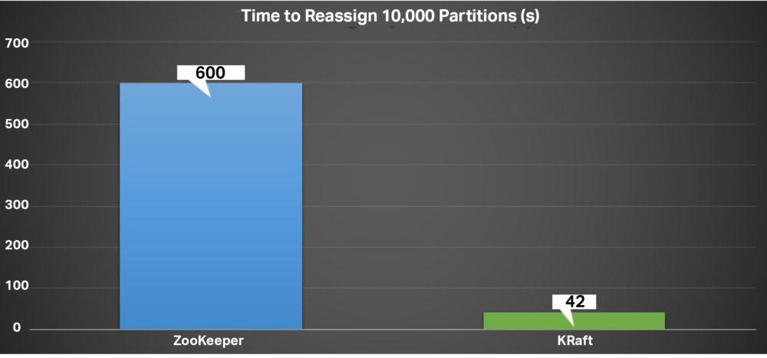
Benchmark
https://www.instaclustr.com/blog/apache-kafka-kraft-abandons-the-zookeeper-part-2-partitions-and-meta-data-performance/

Slide 9
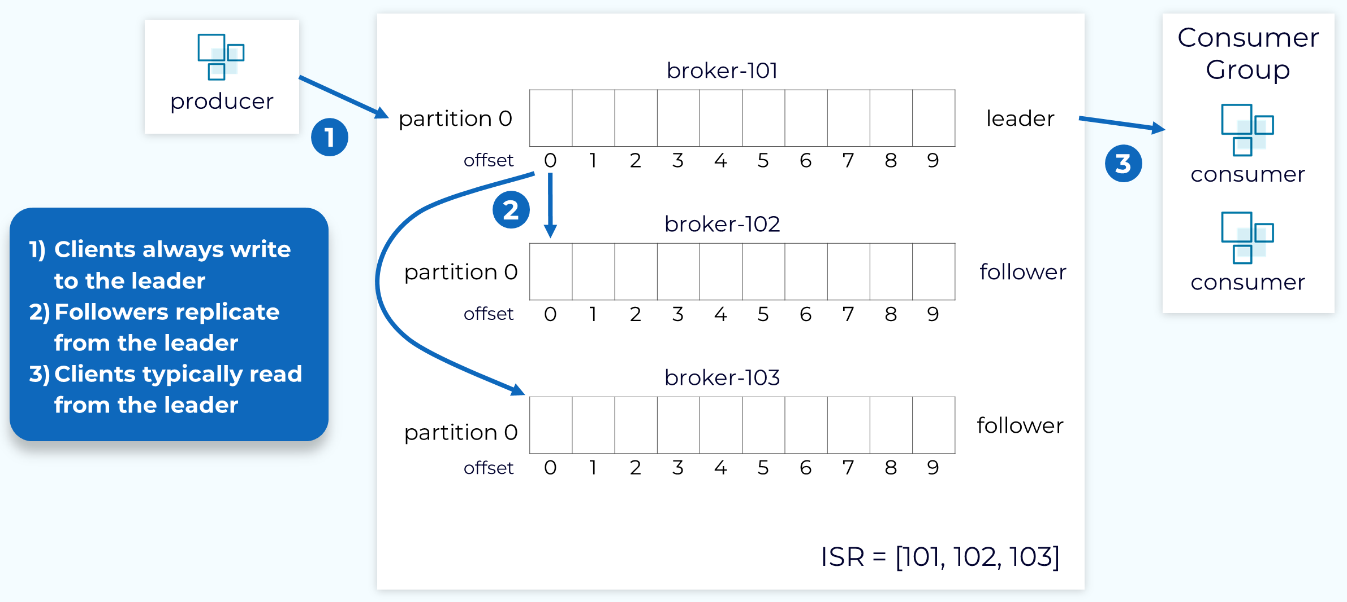
Replication
https://developer.confluent.io/courses/architecture/data-replication/

Slide 10
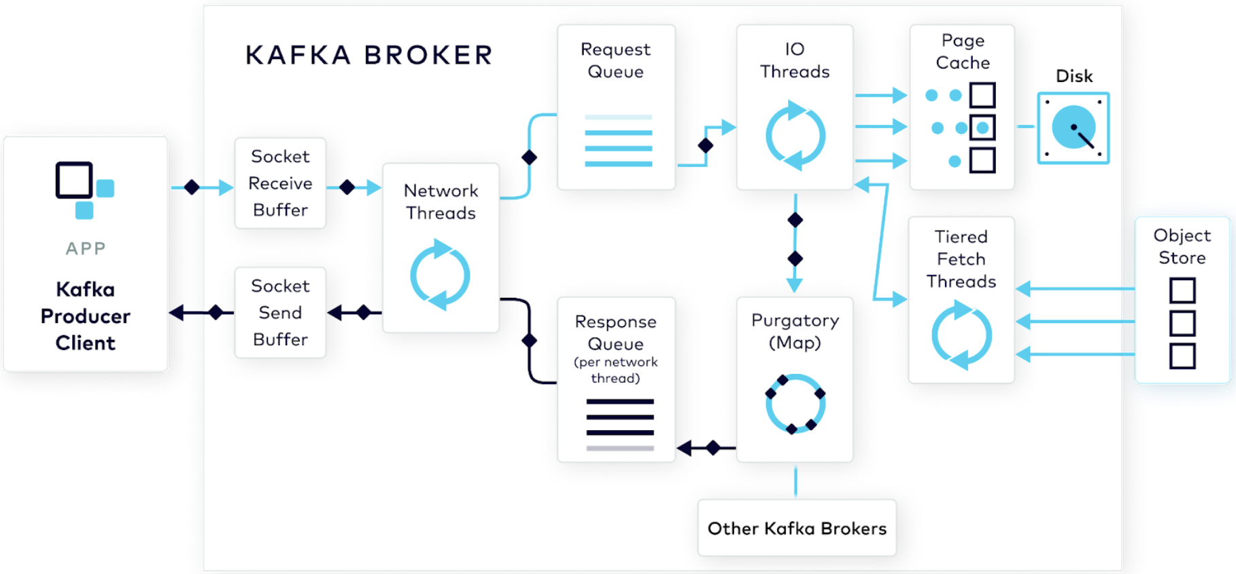
Request Processing
https://www.confluent.io/blog/kafka-producer-internals-handling-producer-request/
Why kafka not use fsync
https://www.redpanda.com/blog/why-fsync-is-needed-for-data-safety-in-kafka-or-non-byzantine-protocols
https://www.architecture-weekly.com/p/how-a-kafka-like-producer-writes

Slide 11
Request Processing
Kafka flushes data to disk based on operating system background threads by default, or via explicit broker/topic configurations (log.flush.interval.messages and log.flush.interval.ms). By default, Kafka relies completely on the OS page cache and disables forced application-level fsync to maximize speed ( Same as IO buffering )

Slide 12
Physical Storage
https://rohithsankepally.github.io/Kafka-Storage-Internals/
Kafka flushes data to disk based on operating system background threads by default, or via explicit broker/topic configurations (log.flush.interval.messages and log.flush.interval.ms). By default, Kafka relies completely on the OS page cache and disables forced application-level fsync to maximize speed ( Same as IO buffering )

Slide 13
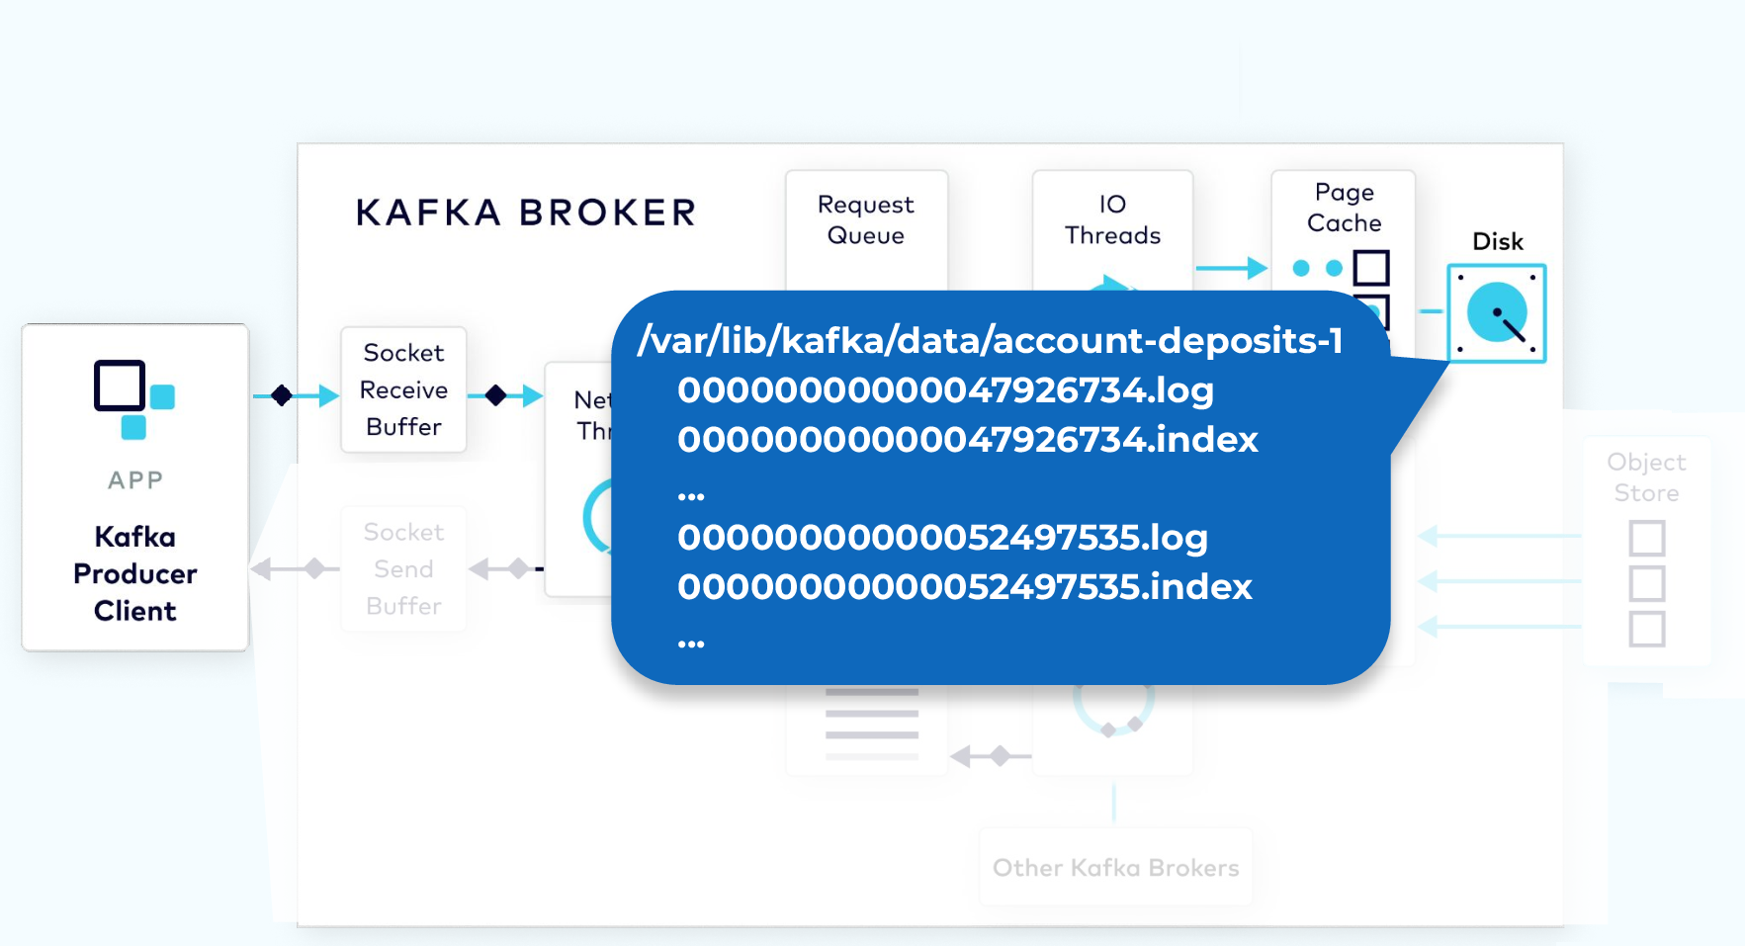
https://stackoverflow.com/questions/19394669/why-do-index-files-exist-in-the-kafka-log-directory
*.Log store actual message
*.index store latest off to increment

